Slide 1


The Online Courseware Revolution and the Potential for a “Global Classroom”
Date: 27 April 2017

Slide 2
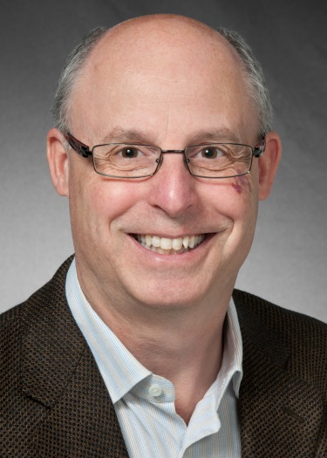


Today’s Speakers
Dr. Steven Furino
Associate Dean for Undergraduate Studies
Faculty of Mathematics,
University of Waterloo
scfurino@uwaterloo.ca
Andrew Rourke
Director
for Teaching Solutions Group,
Maplesoft
ARourke@maplesoft.com
Kenneth C. Green
(Moderator)
Digital Tweed Blogger and Director,
The Campus Computing Project
cgreen@campuscomputing.net

Slide 3

Before We Begin
We are using On24 for today’s webinar. Please enter questions in the text field at the bottom of the Q&A Window. We are monitoring the discussion and will try to bring the Q&A comments into the conversation.
We are recording the webinar; the webinar archive and slides will be available later today.

Slide 4
Poll
Where is your institution in the journey of providing online courses to students?
(Check all that apply)
  Just starting out
  Evaluating technology options for online offering
  Creating content internally
  Looking for content externally
  Have content and know the technology platform we need
MATH Online

Slide 5
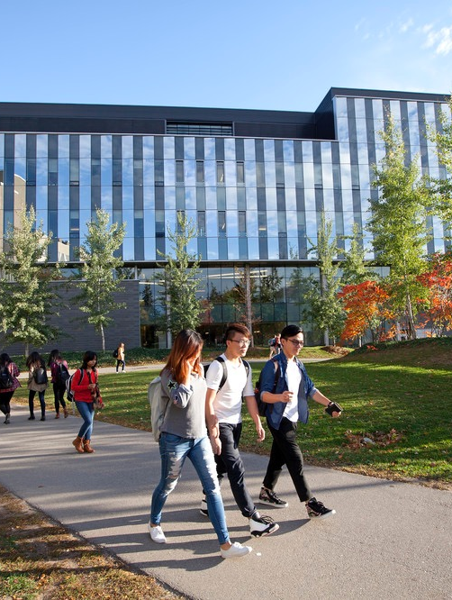
MATH Online
4/27/2017
Presented by: Steven Furino
Associate Dean for Undergraduate Studies
Faculty of Mathematics
University of Waterloo
scfurino@uwaterloo.ca

Slide 6
Faculty of Mathematics
Largest collection of mathematicians and computer scientists in the world
About 7000 honours undergraduates and 1000 graduate students
Roughly 240 faculty members
Hundreds of courses
QS 2017 World Rankings: 31st in Computer Science, 34th in Mathematics
MATH Online

Slide 7
Departments
Applied Mathematics
Centre for Education in Mathematics and Computing
Combinatorics and Optimization
Computer Science
Mathematics and Business
Pure Mathematics
Statistics and Actuarial Science
MATH Online

Slide 8
Question: Spread
We teach roughly 5,000 students differential calculus each fall term across the faculties of Mathematics, Science and Engineering.
The spread in background preparation, native ability and interest is very large.
How do we teach to such large numbers and provide adequate remedial and enrichment opportunities?
MATH Online

Slide 9
Question: Expense
Students and parents are deeply concerned about the costs of education.
Instead of paying $200 for a STEM textbook, many students choose not to acquire a textbook at all and that impairs their ability to study.
How do we replace textbooks without sacrificing quality?
MATH Online

Slide 10
Question: Efficiency
There is enormous interest in producing STEM digital assets.
How do we design, develop and deploy STEM digital assets in a manner which is efficient in authoring time, production cost and maintainability?
MATH Online

Slide 11
Question: Reuse
We teach 26 different calculus courses, many with significant overlap in content but different audiences.
We often need a subset of material from one course in another course.
How do we build digital assets that can be easily shared across courses?
MATH Online

Slide 12
Question: Evidence
Students, parents and the province spend enormous sums of money on higher education.
What empirical evidence do we have that students are learning?
What empirical evidence do we have to support specific changes in instruction or curriculum?
MATH Online

Slide 13
Question: Better Learning
How do we embed the insights of cognitive science into our teaching?
How do we support different modalities of learning: face to face, blended, flipped or wholly online?
How do we provide review and remediation at a time when the student sees the need?
How do we provide enrichment opportunities for our strongest students?
MATH Online

Slide 14
Möbius: Engagement
We need software that can support
Exposition
Experimentation
Exercises
Evaluation
MATH Online

Slide 15
Möbius: Engagement
We need software that can support
Exposition
Experimentation
Exercises
Evaluation
MATH Online

Slide 16
Möbius: Engagement
We need software that can support
Exposition
Experimentation
Exercises
Evaluation
MATH Online

Slide 17
Möbius: Engagement
We need software that can support
Exposition
Experimentation
Exercises
Evaluation
MATH Online

Slide 18
Möbius: Engagement
We need software that can support
Exposition
Experimentation
Exercises
Evaluation
MATH Online

Slide 19
Möbius: Efficacy
and which supports
Enrichment and remediation
and is
Effective pedagogically
Evidence based
Efficient in time and money
MATH Online

Slide 20
MATH Online
Master’s of Mathematics for Teachers (MMT)
Open courseware
Planned: Two undergraduate degrees online – Mathematics and Business Administration (MathBus), Financial Analysis and Risk Management (FARM)
Risk Management, Economic Sustainability and Actuarial Science Development in Indonesia (READI)
African Institute of Mathematical Sciences (AIMS)
Publishers
Corporations
MATH Online

Slide 21
MATH Online
Master’s of Mathematics for Teachers (MMT)
Open courseware
Planned: Two undergraduate degrees online – Mathematics and Business Administration (MathBus), Financial Analysis and Risk Management (FARM)
Risk Management, Economic Sustainability and Actuarial Science Development in Indonesia (READI)
African Institute of Mathematical Sciences (AIMS)
Publishers
Corporations
MATH Online

Slide 22
MATH Online
Master’s of Mathematics for Teachers (MMT)
Open courseware
Planned: Two undergraduate degrees online – Mathematics and Business Administration (MathBus), Financial Analysis and Risk Management (FARM)
Risk Management, Economic Sustainability and Actuarial Science Development in Indonesia (READI)
African Institute of Mathematical Sciences (AIMS)
Publishers
Corporations
MATH Online

Slide 23
MATH Online
Master’s of Mathematics for Teachers (MMT)
Open courseware
Planned: Two undergraduate degrees online – Mathematics and Business Administration (MathBus), Financial Analysis and Risk Management (FARM)
Risk Management, Economic Sustainability and Actuarial Science Development in Indonesia (READI)
African Institute of Mathematical Sciences (AIMS)
Publishers
Corporations
MATH Online

Slide 24
MATH Online
Master’s of Mathematics for Teachers (MMT)
Open courseware
Planned: Two undergraduate degrees online – Mathematics and Business Administration (MathBus), Financial Analysis and Risk Management (FARM)
Risk Management, Economic Sustainability and Actuarial Science Development in Indonesia (READI)
African Institute of Mathematical Sciences (AIMS)
Publishers
Corporations
MATH Online

Slide 25
MATH Online
Master’s of Mathematics for Teachers (MMT)
Open courseware
Planned: Two undergraduate degrees online – Mathematics and Business Administration (MathBus), Financial Analysis and Risk Management (FARM)
Risk Management, Economic Sustainability and Actuarial Science Development in Indonesia (READI)
African Institute of Mathematical Sciences (AIMS)
Publishers
Corporations
MATH Online

Slide 26
MATH Online
Master’s of Mathematics for Teachers (MMT)
Open courseware
Planned: Two undergraduate degrees online – Mathematics and Business Administration (MathBus), Financial Analysis and Risk Management (FARM)
Risk Management, Economic Sustainability and Actuarial Science Development in Indonesia (READI)
African Institute of Mathematical Sciences (AIMS)
Publishers
Corporations
MATH Online

Slide 27
Sites
Parentheses contain page views in trailing twelve months. Sites in blue are built in Möbius.
courseware.cemc.uwaterloo.ca (1,300,000)
open.cs.uwaterloo.ca (370,000)
open.math.uwaterloo.ca (127,000, courseware for linear algebra)
open.engineering.uwaterloo.ca (80,000, course support for one course in one semester)
readi.uwaterloo.ca (requires login, 6,500 from 20 workshop participants in two weeks)
open.science.uwaterloo.ca (not yet public)
MATH Online

Slide 28
Poll
How many STEM courses are offered wholly online at your institution each year?
0
1 – 19
20 – 39
> 40

Slide 29


Inside Higher Ed Webinar
April 2017
Möbius - Solution for the Challenges of Bringing and Teaching STEM Online
Andrew Rourke,
Director, Teaching Solutions Group Maplesoft

Slide 30
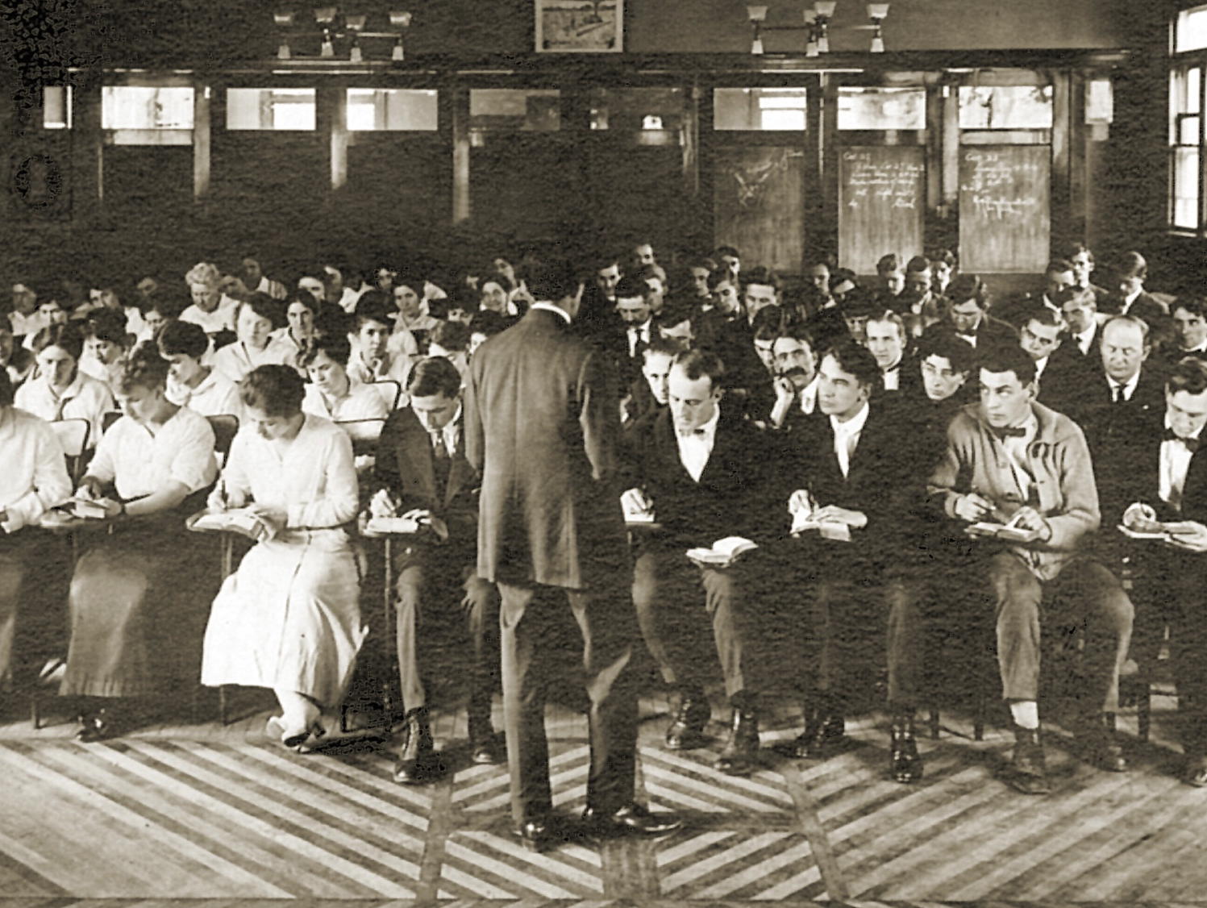
Insert 2 pictures; lecture hall from 150 years ago and today

Slide 31

Insert 2 pictures; lecture hall from 150 years ago and today

Slide 32
Online Education –
STEM the past 10 years:
MOOCs – failed to deliver
Certification, Badging and Credentialing – still struggling
Technology struggles

Slide 33




Online Education –
STEM the past 10 years:
Online Learning 1.0
Online Learning 2.0

Slide 34


You have a lot to consider if you are
moving STEM courses online
What to consider, even before you begin:
Costs
Range of Learner
Measurement and Analytics

Slide 35

Costs
Significant costs to develop and maintain courses
  Assume 1 full year of development for a STEM course: from develop to deploy
  Decisions need to be made as to who will be involved in the development process
Must ensure:
  improved learning outcomes
  an engaging and pleasing student experience – rich & multi-level
  cost efficiency to build/maintain courses
  an efficient process to minimize required resources

Slide 36
Range of Learner
No two students are equal in knowledge or background
In-class experience requires that instructors teach to the ‘lowest common student’
Span the spectrum from enrichment to remediation
Students “learn by doing” and engaging with the content and materials
Only when a student practices math will they actually learn math-based concepts

Slide 37
Measurement and Analytics
What do you know today… what don’t you know today?
  “Once learning software objects become widely used, campuses will be awash in data-which is bound to revolutionize our understanding of student learning and how to analyze it.”
  Massy, William. Reengineering the University

Slide 38

Administrators trying to move
STEM courses online:
Overhead costs without
clear/measureable results
Lack of development resources
Scalability challenges

Slide 39

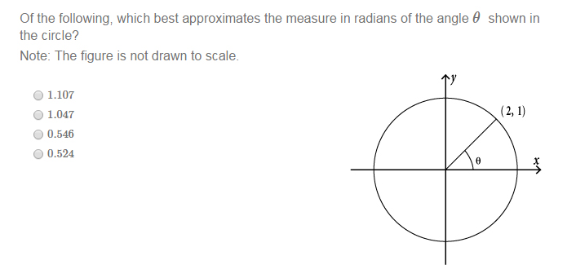
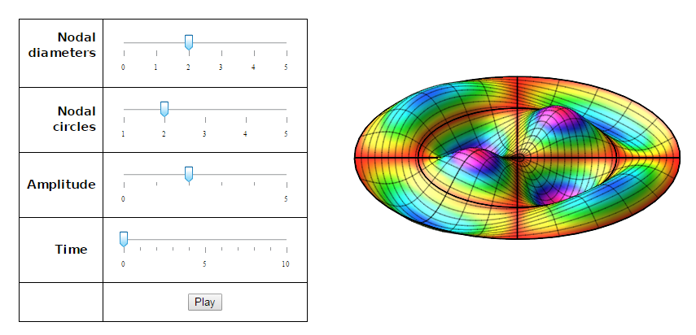

Professors trying to move
STEM courses online:

Slide 40

Education Landscape Today:
Students today are “digital natives”
Education should be as connected as the rest of their lives
At least as good as online materials
We must teach ‘Critical Thinking’
What about the future?

Slide 41
Students learn by doing…
Can students apply the concepts
to solve problems?
Identify learning breakdowns
“I hear and I forget. I see and I remember.
I do and I understand.” …Confucius

Slide 42


Slide 43
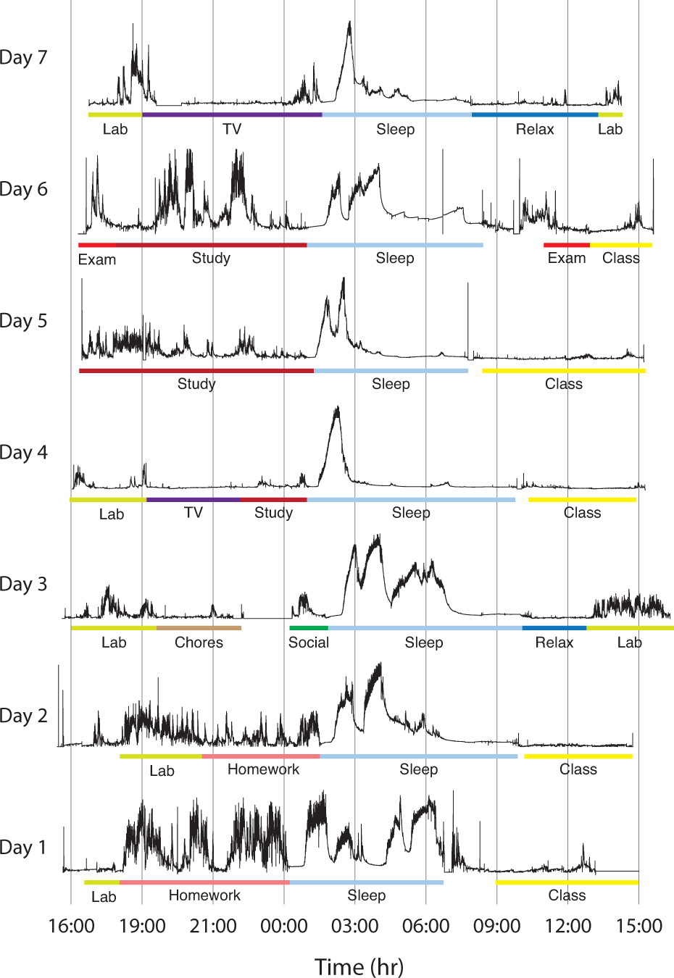
Paper by researchers from MIT, MHP and Harvard: A Wearable Sensor for Unobtrusive, Long-Term Assessment of Electrodermal Activity, IEEE TRANSACTIONS ON BIOMEDICAL ENGINEERING, VOL. 57, NO. 5, MAY 2010

Slide 44
The Environment Today: 3.0
Learn-by-doing
Integrated
Competency-based
Asynchronous
Adaptive
Modern UX
Mobile
Rich analytics
Social
Coaching/Mentoring
Personalized
Gamified
Life-long learning
Video Cohorts
Online Learning 3.0

Slide 45
Möbius

Slide 46
Möbius is an Mobius is an affordable platform for creating, deploying and managing online STEM courseware that focuses on continuous assessment throughout the learning process.
Secondly, it provides a framework to guide students through the materials that are best suited to their own needs.

Slide 47





“Behind the scenes…”

Slide 48

Next steps:
Start developing today!
Pilot?
Evaluate?
Review & Discuss?
  arourke@maplesoft.com
`

Slide 49
Maplesoft Resources
Whitepaper: The Evolution and Revolution of Online Education
Whitepaper: Your Online Students Aren’t Paying Attention!
Case Study: Instructor uses Möbius to enhance learning for first-year engineering students at the University of Birmingham
Case Study: Perimeter Institute Uses Möbius in Physics Camp for High Achieving Students
Case Study: Secondary School Courseware Uses Maplesoft Technology to Prepare Students for Post-Secondary Education

Slide 50

Thank You!
Questions?
Dr. Steven Furino
University of Waterloo
scfurino@uwaterloo.ca
Andrew Rourke
Maplesoft
ARourke@maplesoft.com

